Slide 1
2nd
Period
English Grade 6
Lesson 10
Lesson 10
Who Wrote the Book?
(p156~157)

Slide 2
Let’s Review

Slide 3
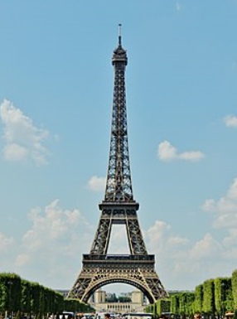
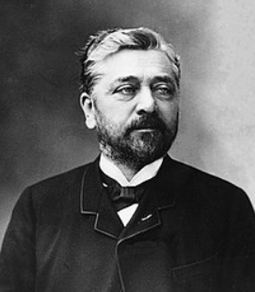
Let’s Review
Who built the Tower?
Eiffel did.
이미지 출처: https://ko.wikipedia.org/wiki/%EC%97%90%ED%8E%A0%ED%83%91 https://ko.wikipedia.org/wiki/%EA%B7%80%EC%8A%A4%ED%83%80%EB%B8%8C_%EC%97%90%ED%8E%A0

Slide 4
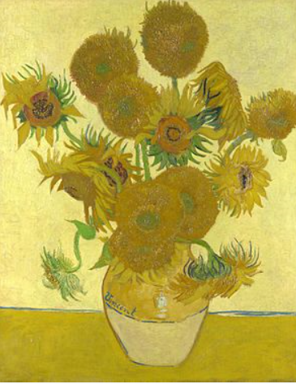
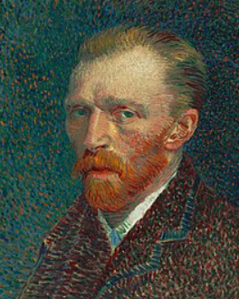
Let’s Review
Who drew the picture?
Van Gogh did.
이미지 출처: https://en.wikipedia.org/wiki/Sunflowers_(Van_Gogh_series)
https://en.wikipedia.org/wiki/Vincent_van_Gogh

Slide 5
Learning Point
누가 한 일인지 묻고 답하는 말하기
상대방인 한 말을 확인하는 말하기

Slide 7
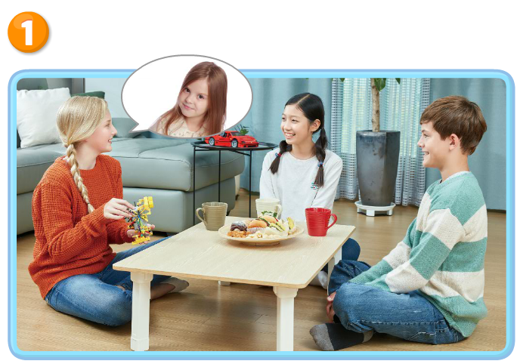
Real Talk Scene 1

Slide 8
Real Talk Scene 1 Let’s Listen

Slide 9
Real Talk Scene 1 Let’s Listen Again

Slide 10
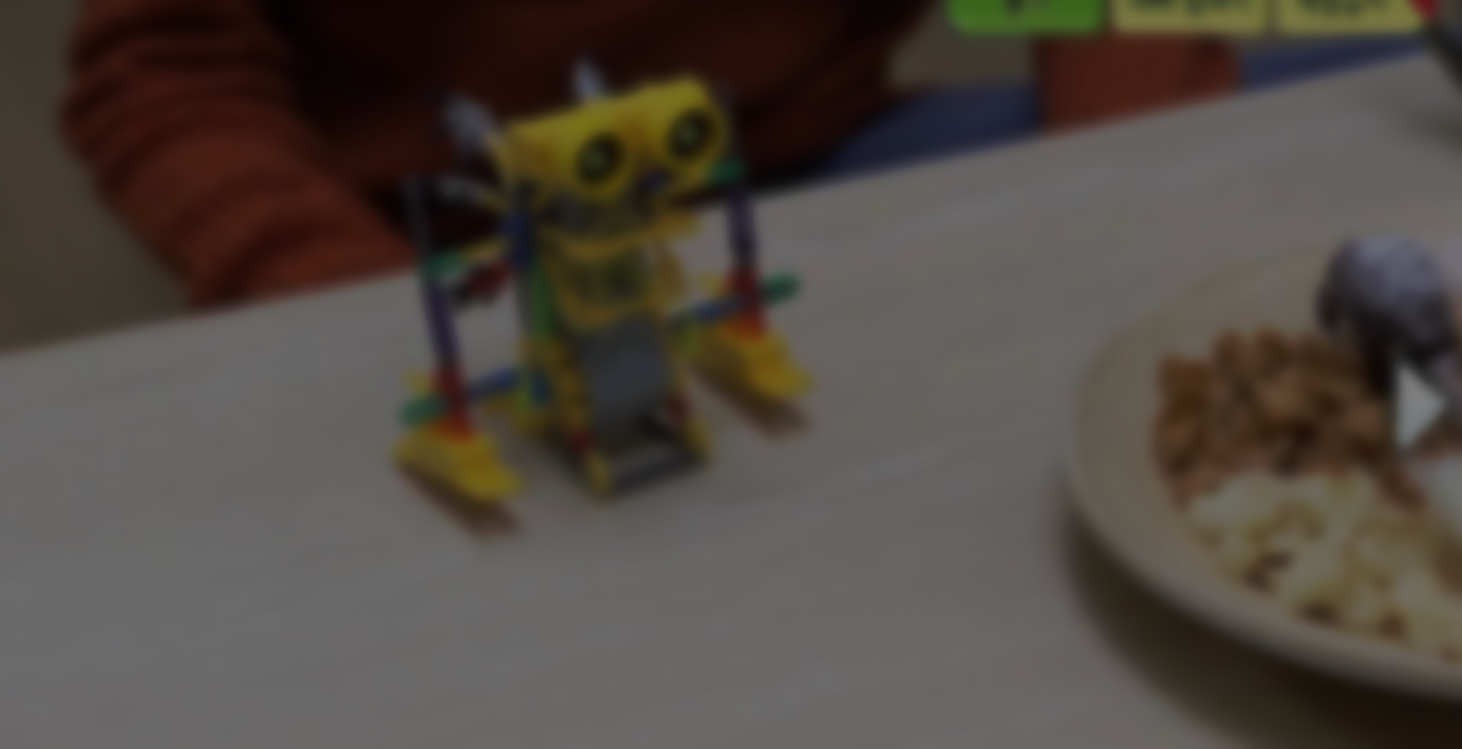
Listen and Comprehend
`
Look at this robot!
Wow, it’s cool.
Who made the robot?
My younger sister did.

Slide 11
Listen and Comprehend
`
Your younger sister?
Yes. She likes making things.
She made that car, too.
Wow, she’s great!

Slide 12
Listen and Repeat
`
Look at this robot!
Wow, it’s cool.
Who made the robot?
My younger sister did.

Slide 13
Listen and
Repeat
`
Your younger sister?
Yes. She likes making things.
She made that car, too.
Wow, she’s great!

Slide 14
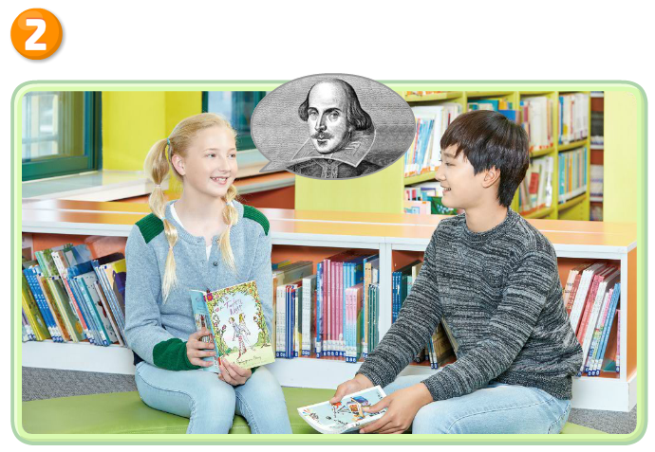
Real Talk Scene 2

Slide 15
Real Talk Scene 2 Let’s Listen

Slide 16
Real Talk Scene 2 Let’s Listen Again

Slide 17
Listen and Comprehend
`
What are you reading, Kelly?
Twelfth Night. It’s very interesting.
Who wrote the story?
Shakespeare did.

Slide 18
Listen and Comprehend
`
Did you say Shakespeare?
Yes, I did.
I like his books.
Romeo and Juliet is my favorite story.

Slide 19
Listen and
Repeat
`
What are you reading, Kelly?
Twelfth Night. It’s very interesting.
Who wrote the story?
Shakespeare did.

Slide 20
Listen and
Repeat
`
Did you say Shakespeare?
Yes, I did.
I like his books.
Romeo and Juliet is my favorite story.

Slide 21
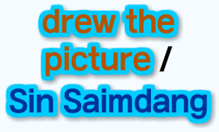
Talk Together

Slide 22
Talk Together

Slide 23
Culture Link

Slide 24
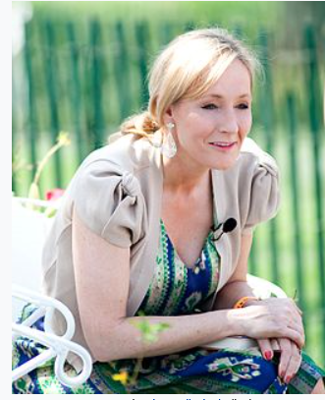
Review
Who wrote Harry Potter and the Philosopher’s stone?
J.K. Rolling did.
이미지 출처: https://en.wikipedia.org/wiki/Harry_Potter_and_the_Philosopher%27s_Stone https://ko.wikipedia.org/wiki/J._K._%EB%A1%A4%EB%A7%81

Slide 25
Your Work
1
Real Talk 다시 듣고 따라 말하기
2
Talk Together에 제시된 어구
공책에 적어보기
3
Point Check 문제 스스로 해결하기

Slide 26
이 영상에 사용한 교과서의 지문, 삽화, 음원, 영상 등
모든 교과서 자료는 (주)천재교육에 저작재산권이 있습니다.
이 영상의 저작재산권은 제작자에게 있습니다
이 영상은 각 초등학교에서 수업에 사용할 수 있습니다.
이 외의 방법과 목적으로 이 영상을 사용하거나
일부 또는 전부를 저장 장치에 저장하거나,
일부 또는 전부를 다른 자료에 사용하는 것은
저작권법에 위배될 수 있음을 알려드립니다.

