Slide 1
2nd
Period
English Grade 6
Lesson 9
Lesson 9
What Do You Think?
(p142~143)

Slide 2
Let’s Review

Slide 3
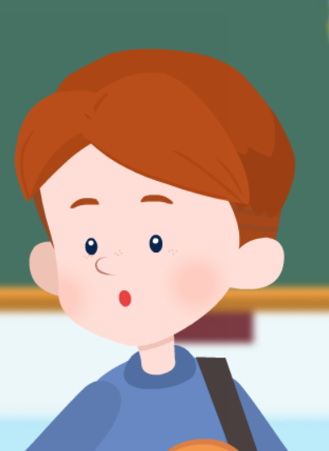
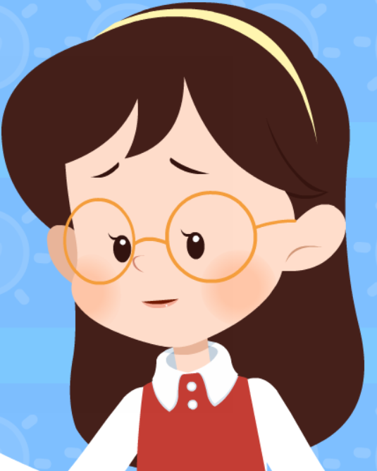
Let’s Review

Slide 4
Learning Point
동의 여부를 묻고 답하는 말하기
의견을 나타내는 말하기

Slide 5
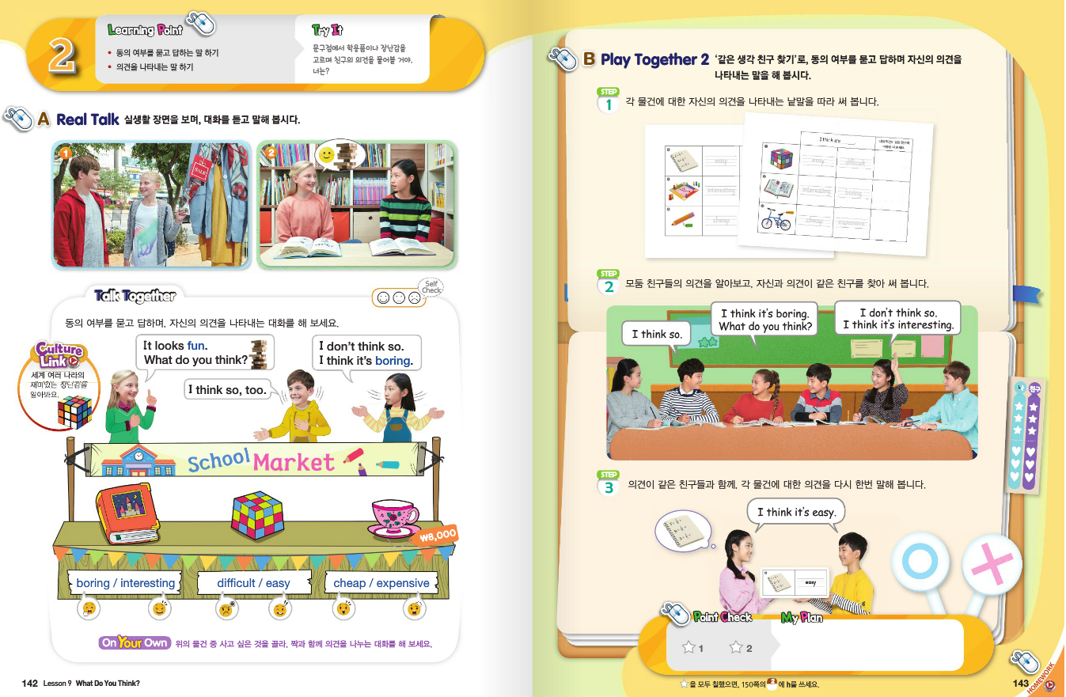
Fun Time

Slide 6
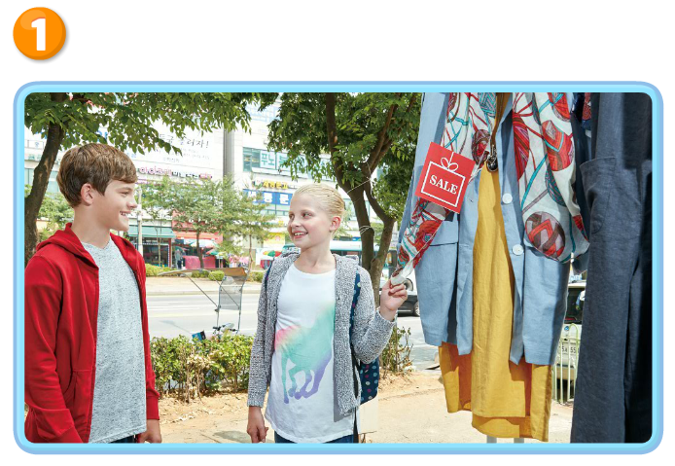
Real Talk Scene 1

Slide 7
Real Talk Scene 1 Let’s Listen

Slide 8
Real Talk Scene 1 Let’s Listen Again

Slide 9
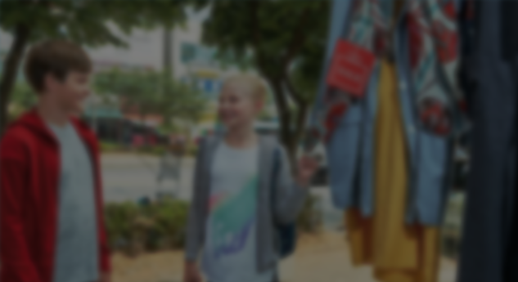
Listen and Comprehend
`
Mom’s birthday is coming.
Let’s buy a present for her.
That’s a good idea.
Look at that scarf.
It’s on sale.

Slide 10
Listen and Comprehend
`
It looks pretty.
What do you think?
I think so.
Mom will like it.

Slide 11
Listen and Repeat
`
Mom’s birthday is coming.
Let’s buy a present for her.
That’s a good idea.
Look at that scarf.
It’s on sale.

Slide 12
Listen and Repeat
`
It looks pretty.
What do you think?
I think so.
Mom will like it.

Slide 13
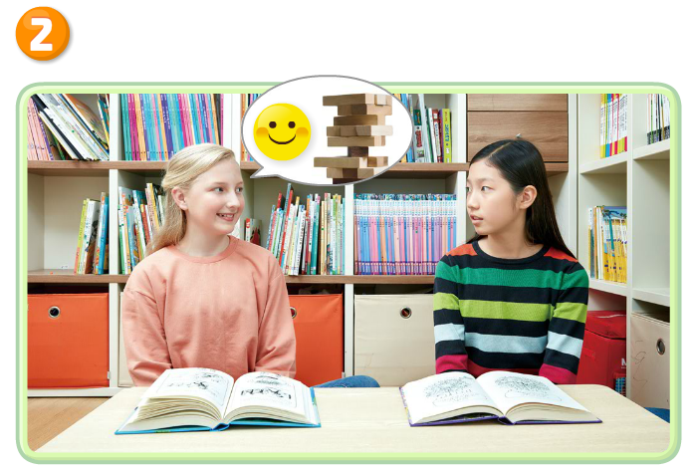
Real Talk Scene 2

Slide 14
Real Talk Scene 2 Let’s Listen

Slide 15
Real Talk Scene 2 Let’s Listen Again

Slide 16
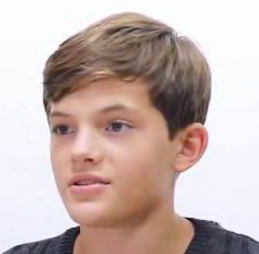
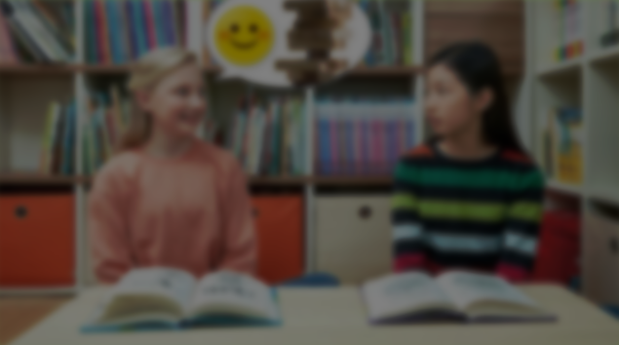
Listen and Comprehend
`
Kelly, Sora, let’s play Jenga.
It look fun.
What do you think, Sora?
I don’t think so.
I think it’s boring.

Slide 17
Listen and Comprehend
`
How about this game?
It’s interesting.
Oh, I like that game.
Good. Let’s play it.

Slide 18
Listen and Repeat
`
Kelly, Sora, let’s play Jenga.
It look fun.
What do you think, Sora?
I don’t think so.
I think it’s boring.

Slide 19
Listen and Repeat
`
How about this game?
It’s interesting.
Oh, I like that game.
Good. Let’s play it.

Slide 20
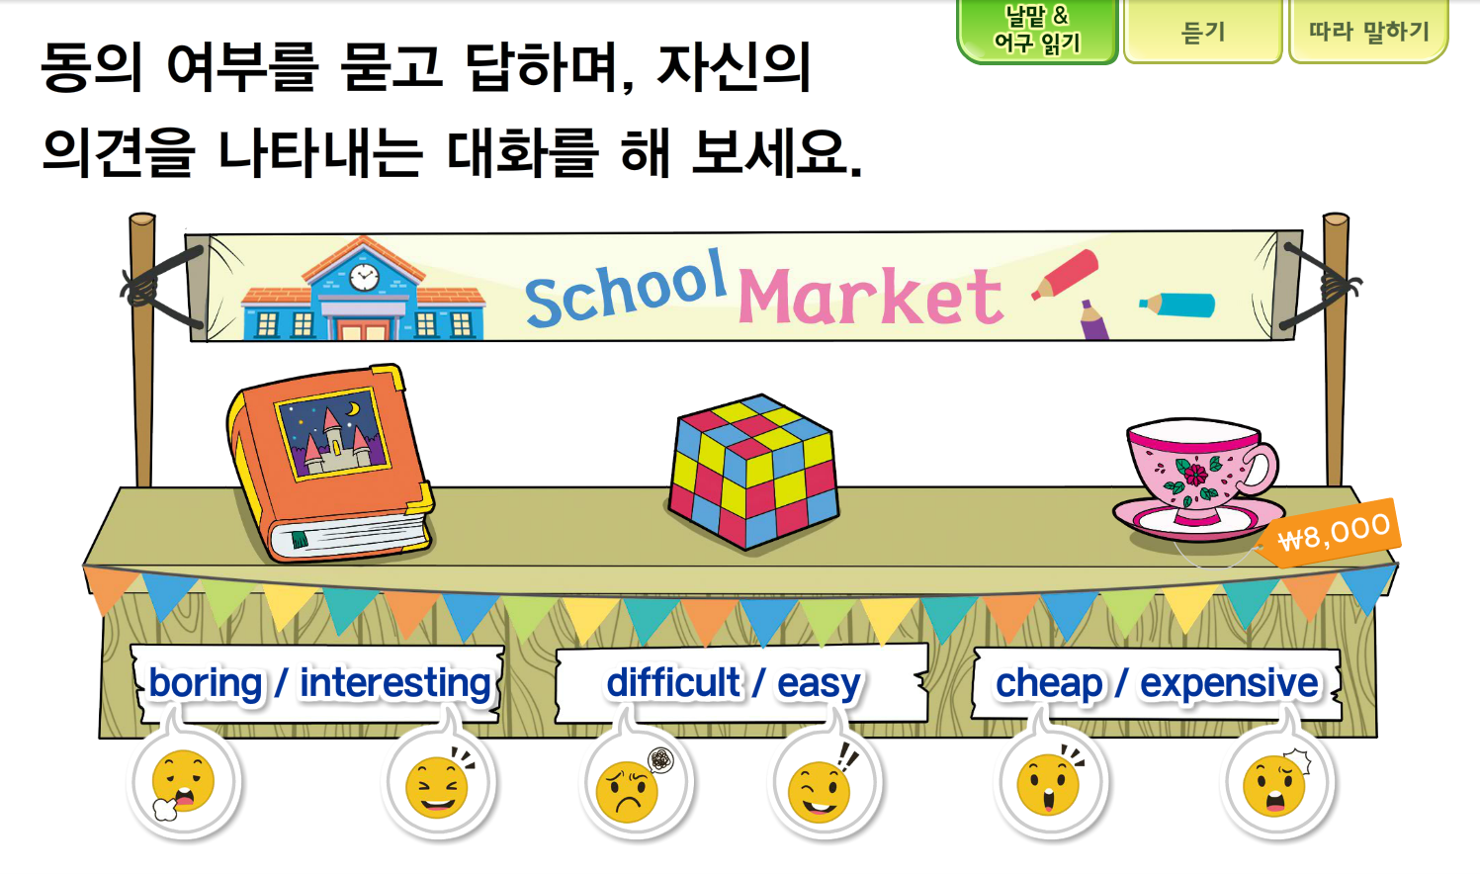
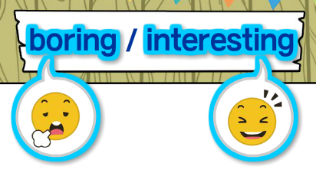
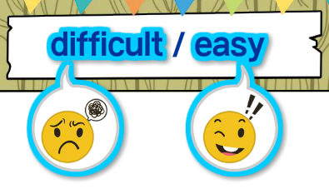
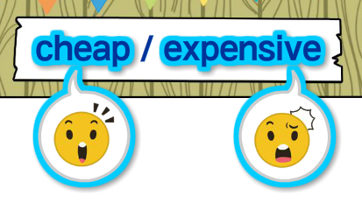
Talk Together

Slide 21
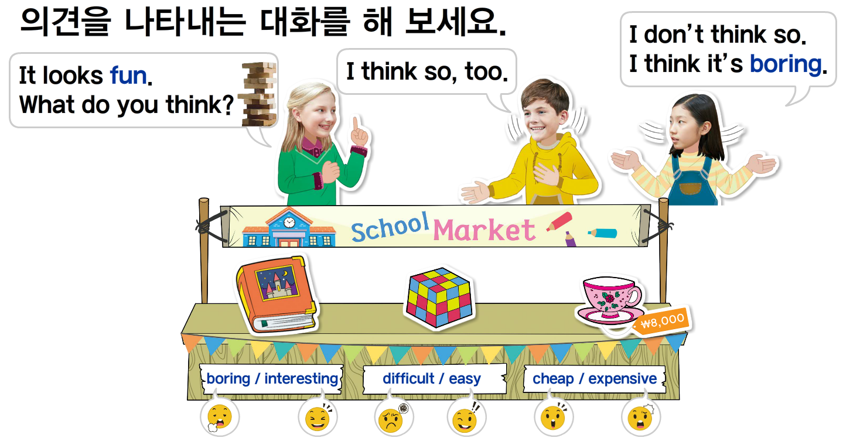
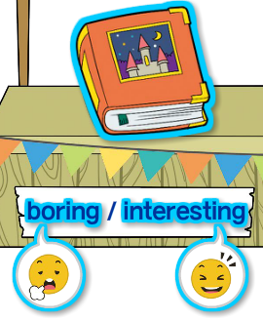
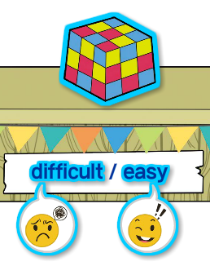
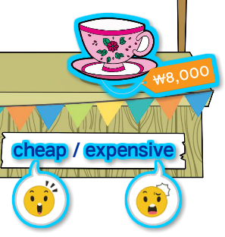
Talk Together

Slide 22
Culture Link

Slide 23
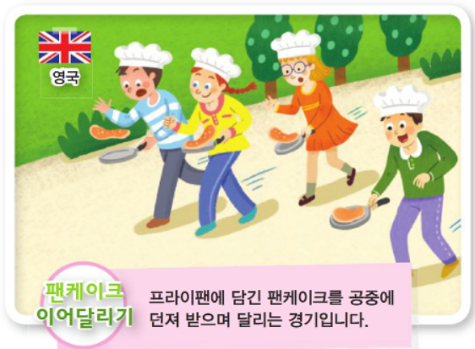
Fun Time
`
It looks fun.
What do you think?
I think so. It looks fun.
I don’t think so. It looks boring.

Slide 24
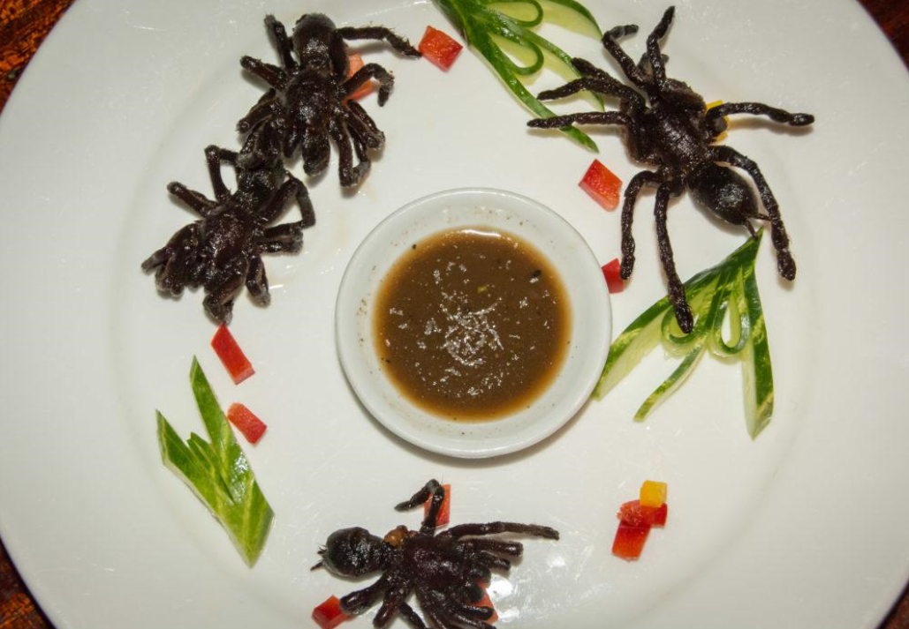
Fun Time
`
It looks delicious.
What do you think?
I think so. It looks delicious.
I don’t think so. It looks scary.

Slide 25
Your Work
1
Real Talk 다시 듣고 따라 말하기
2
Talk Together에 제시된 어구
공책에 적어보기
3
Point Check 문제 스스로 해결하기

Slide 26
이 영상에 사용한 교과서의 지문, 삽화, 음원, 영상 등
모든 교과서 자료는 (주)천재교육에 저작재산권이 있습니다.
이 영상의 저작재산권은 제작자에게 있습니다
이 영상은 각 초등학교에서 수업에 사용할 수 있습니다.
이 외의 방법과 목적으로 이 영상을 사용하거나
일부 또는 전부를 저장 장치에 저장하거나,
일부 또는 전부를 다른 자료에 사용하는 것은
저작권법에 위배될 수 있음을 알려드립니다.

